Slide 1

Research Question – Tutorial Presentation for Feedback Date: 24 - 11 - 2025
Group Name: A 104 Name of Student Presenting: Faraaz Malik

Slide 2
Variables included in our research question: Occupation, Stress Level
5 rows of the dataset
Our dataset has a total of 374 rows and 13 columns.
Here is a sample of our dataset:
Person ID | Gender | Age | Occupation | Sleep Duration | Quality of Sleep | Physical Activity Level | Stress Level | BMI Category | Blood Pressure | Heart Rate | Daily Steps | Sleep Disorder
1 | Male | 27 | Software Engineer | 6.1 | 6 | 42 | 6 | Over-weight | 126/83 | 77 | 4200 | None
2 | Male | 28 | Doctor | 6.2 | 6 | 60 | 8 | Normal | 125/80 | 75 | 10000 | None
3 | Male | 28 | Doctor | 6.2 | 6 | 60 | 8 | Normal | 125/80 | 75 | 10000 | None
4 | Male | 28 | Sales Representative | 5.9 | 4 | 30 | 8 | Obese | 140/90 | 85 | 3000 | Sleep Apnea
5 | Male | 28 | Sales Representative | 5.9 | 4 | 30 | 8 | Obese | 140/90 | 85 | 3000 | Sleep Apnea

Slide 3
This dataset is interesting to us because it gives an insight on how lifestyle habits can affect the well-being of people from various professional backgrounds. Our Independent variable: Occupation ; Doctor, Software Engineer Independent variable datatype: Nominal Our Dependent variable: Stress Level Dependent variable datatype: Ordinal
Dataset ID: DS355 - Sleep_health_and_lifestyle_dataset.csv
Notes:
Before specifying your Research Question you must define the type of data you are analysing. Are the variables you select interval data (measurement data you can divide, multiple, etc), OR are they ordinal (there is a definite order but the intervals between each variable are not necessarily equal, or the terms might be subjective like in a likert scale); OR are they just categorical/nominal (Items such as film names, cities, etc., that you can count numbers of occurrences? You also need to understand whether the variable is either dependent or independent and this will vary according to the context. Independent variables may cause an effect, whereas the dependent variable might be effected by the independent variable. Check the lecture notes on the RQ for more information and examples.
You will get only one opportunity to present your Research Question ahead of the submission date. Have your questions ready, and be ready to take notes on feedback.

Slide 4
Template ¹: Is there a difference in the median stress level between doctors and software engineers in the 27 to 59 age group? (declaration of synthetic data)
Our Research Question is
Null hypothesis (H₀): There is no difference in the median of stress level between doctors and software engineers in the 27 to 59 age group.
Alternative hypothesis (H₁): There is a difference in the median of stress level between doctors and software engineers in the 27 to 59 age group.
¹Correlation (Analysis of how ordinal/interval dependent var correlates to an ordinal/interval independent variable)
²Comparison of means (or medians): Analysis of the difference between the mean (or median) value of a characteristic shared by members of two different populations.
³Comparison of proportions: Analysis of the difference in proportions of a characteristic shared by members of two different populations.

Slide 5
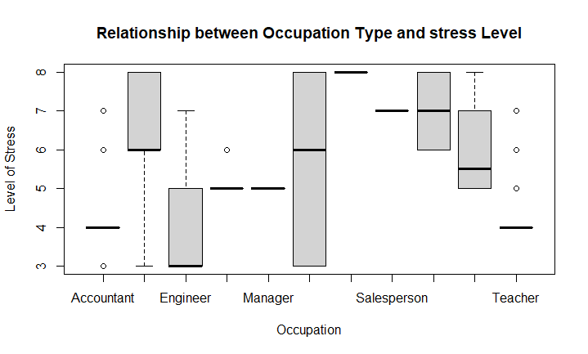
BoxPlot

Slide 6
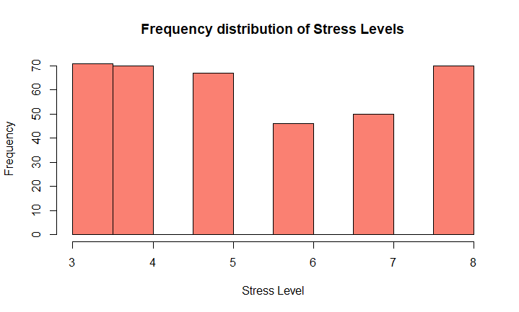
Histogram

